Slide 1


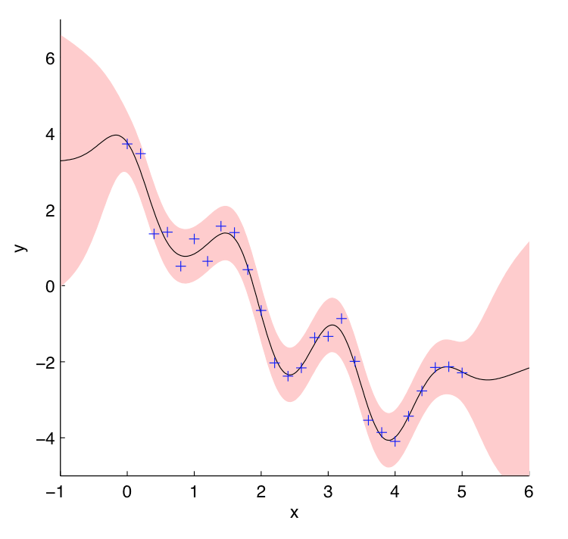
Gaussian Processes for Regressions:
A Quick Introduction
M. Ebden, 2008
Drew Ellison
January 30, 2015

Slide 2
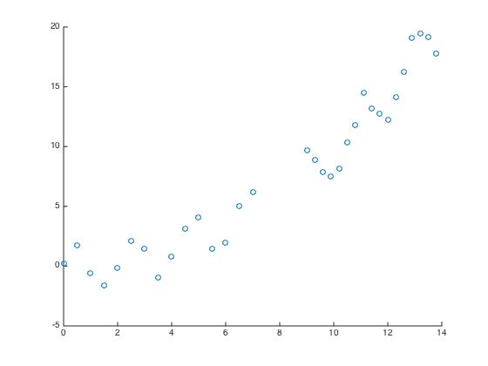
Assume we have some data that we want to fit:

Slide 3
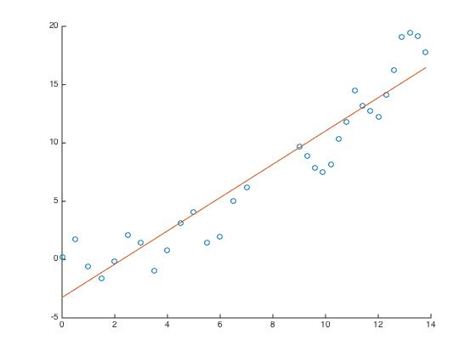
Maybe we could fit it with a line:

Slide 4
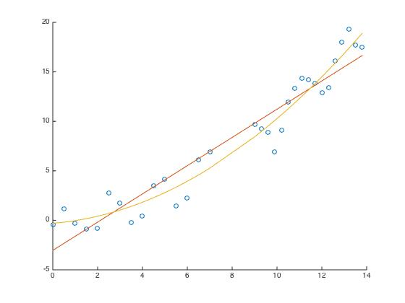
Or a parabola:

Slide 5
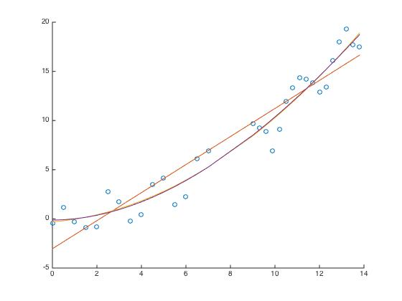
Or a cubic (Pretty much same as parabola):

Slide 6
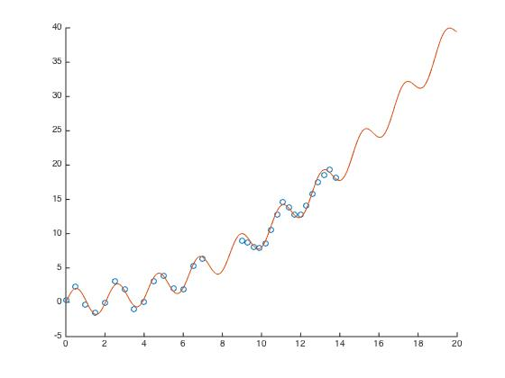
But in reality, the true model is too complex to be captured by polynomials:

Slide 7
Maybe we want to use a less parametric model and rather, “let the data speak for itself.”
We could use the data we have to generate a model for predicting new data points using Gaussian Processes (GPs)

Slide 8
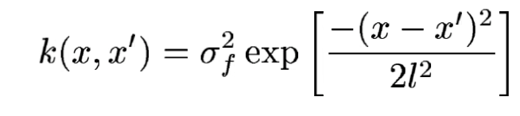
Maybe we want to use a less parametric model and rather, “let the data speak for itself.”
We could use the data we have to generate a model for predicting new data points using Gaussian Processes (GPs)
Covariance Function

Slide 9
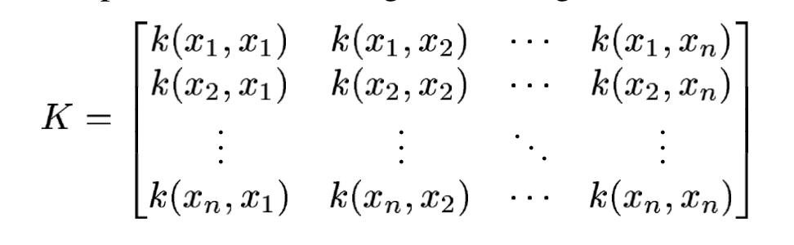

Slide 10
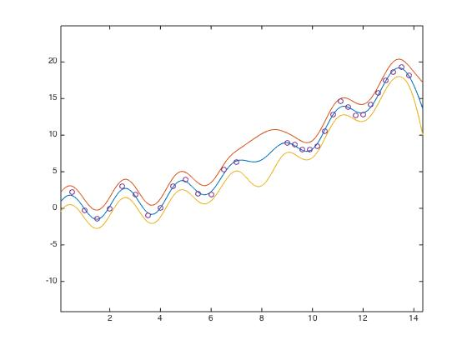

Slide 11
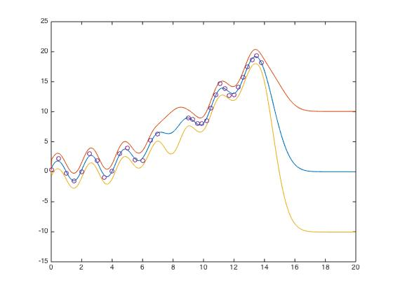

Slide 12
